Slide 1
Grid Lots Sales Dashboard
Abner Misigina, May 2021

Slide 2
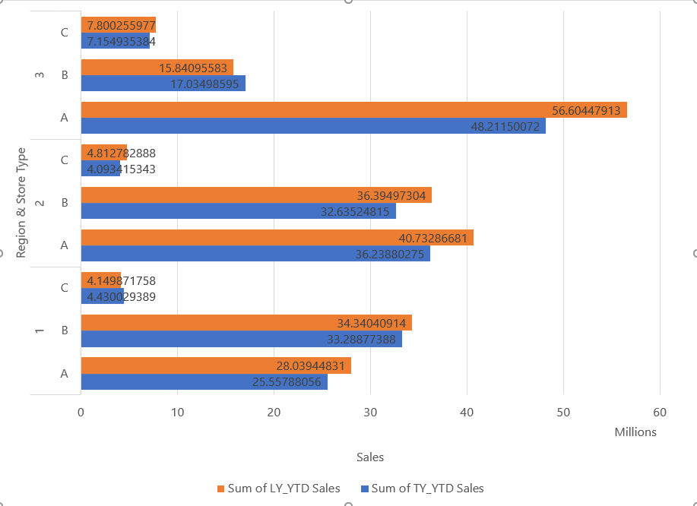
TY vs LY YTD Sales by Region & Store Type
N.B. TY = This Year, LY=Last Year, YTD=Year To Date

Slide 3
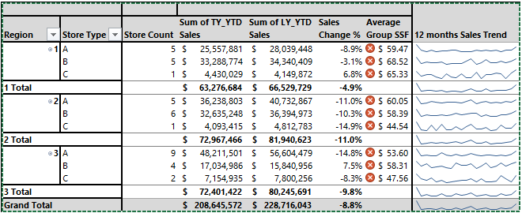
Detailed Sales Statistics by Region & Store Type
N.B. SSF=Sales per Square Foot

Slide 4
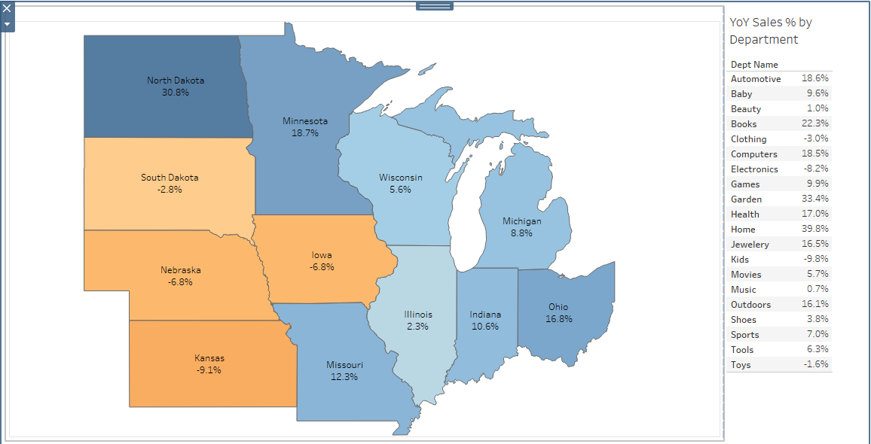
Year-over-Year Sales Change by State & Department

Slide 5
Reference
To get the detailed dashboard:
On MS Excel: https://1drv.ms/x/s!ArGmfbQ9HI3_iBWc28D1Sm7UDD0A?e=Q3KcNS
On Tableau: https://public.tableau.com/profile/abner.m6475#!/vizhome/UpdatedSalesDashboardforChallengeAbnerM/Story1?publish=yes

